Slide 1

Model-Predictive Control based Energy Management and Analysis of Dual-Motor Electric Vehicles
Faculty Committee:
Dr. Yan Chen, Chair Dr. Junfeng Zhao Dr. Dajiang Suo
Presented by:
Harsh Gangwar

Slide 2
Agenda
Motivation (Why?)
Background (What exists?)
Approach (How)
Findings
Future Work

Slide 3
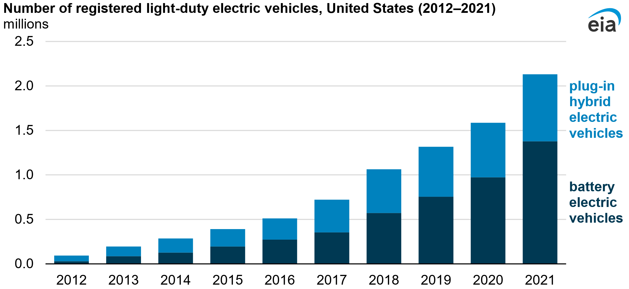
Motivations
Evolution of Electric Vehicle Powertrains
According to Reuters, EV sales projected to capture up to 33% of global market share by 2028.
Global Automotive Outlook briefing, “Investment of at least $526 billion on EVs and batteries from 2022-2026”.
Expansion of EV market drives demand for enhanced performance, efficiency, and vehicle control capabilities.

Slide 4
Motivations
Motivation for MPC Enhanced Energy Management
Energy requirement: Princeton's data, by 2035 light-duty vehicles, could see a staggering increase of up to 3,360% in electricity usage compared to current levels.
Range: According to the Alternative Fuels Data Center, The median range for eVs in the 2021 model year was 234 miles. The average distance between charging stations in California is 10 miles, but in Nebraska, it's 465 miles.
Current energy management strategies often rely on heuristic rules or simple control algorithms. MPC can do better.
Integration of multiple electric motors enables features like all-wheel drive, improved acceleration, and enhanced vehicle control.

Slide 5
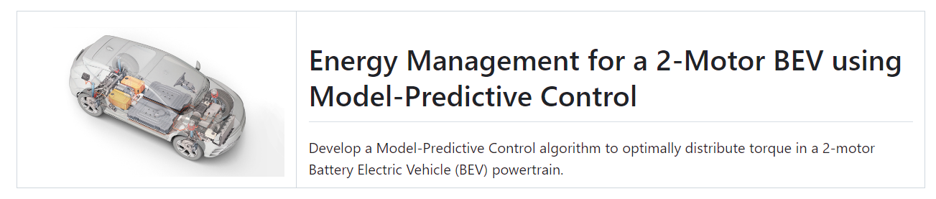
Motivations
MATLAB Simulink Challenge Project 246: Enhancing Electric Vehicle Efficiency with MPC
Suitable for Master's and Doctoral candidates seeking advanced research and implementation opportunities.

Slide 6
Motivations
Project Components and Requisites
Utilize Powertrain Blockset to generate a 2-motor BEV model in Simulink.
Replicate vehicle dynamics during various drive cycles for performance evaluation.
Perform rigorous simulation and testing across different drive cycles (WLTP Class 3, FTP75, and US06).
Evaluate effectiveness by comparing energy consumption and driving range enhancements achieved by the MPC algorithm.

Slide 7
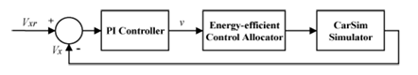
Literature Review
Fast and Global Optimal Energy-Efficient Control Allocation with Applications to Over-Actuated Electric Ground Vehicles Chen and Wang (2012)
Proposal of a global optimization algorithm.
Velocity controlled using PID controller and Energy-efficient control allocation implemented using KKT condition.
The resulting controller was validated using CarSim simulation and strategy was better than existing active set methods.

Slide 8
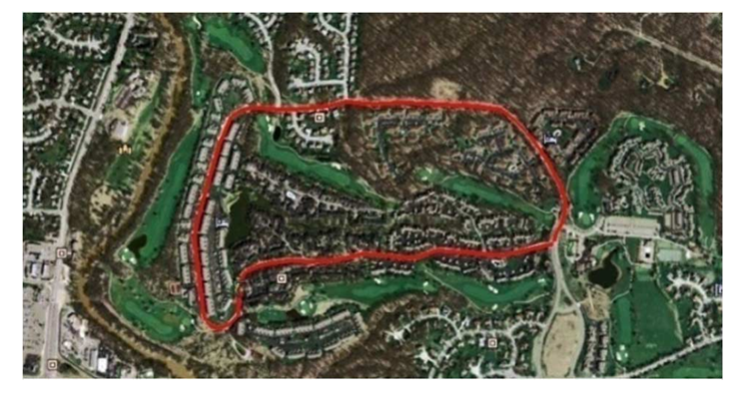
Literature Review
Energy Management and Driving Strategy for In-Wheel Motor Electric Ground Vehicles with Terrain Profile Preview, Chen et al (2014)
Introduced a novel energy management and driving strategy for in-wheel motor electric ground vehicles.
Concluded that the DP method shows a greater improvement for the EGV energy saving than the MPC method.
Highlighted the influence of terrain, vehicle
characteristics, and real-time traffic data on energy
consumption.

Slide 9
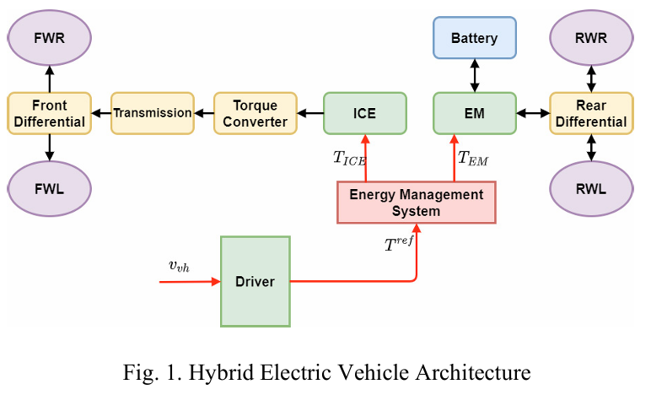
Literature Review
Processor-In-the-Loop Management Demonstration of MPC for HEVs Energy System, Cavanini et al (2022)
Demonstrated Model Predictive Control (MPC) for Hybrid Electric Vehicles (HEVs) energy management system..
Focus: Optimizing energy flow within HEVs
to minimize fuel consumption and emissions while
ensuring optimal vehicle performance.
Validated via Processor-In-the-Loop (PIL)
setup.

Slide 10
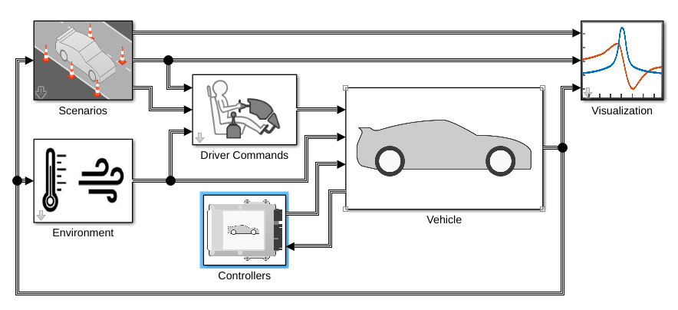
Approach
Virtual Vehicle Composer
Key Features
Fuel Economy Analysis: Evaluate fuel efficiency of the vehicle.
Battery State of Charge: Monitor and analyze battery charge levels.
Drive Cycle Tracking: Assess vehicle performance across different driving conditions.

Slide 11
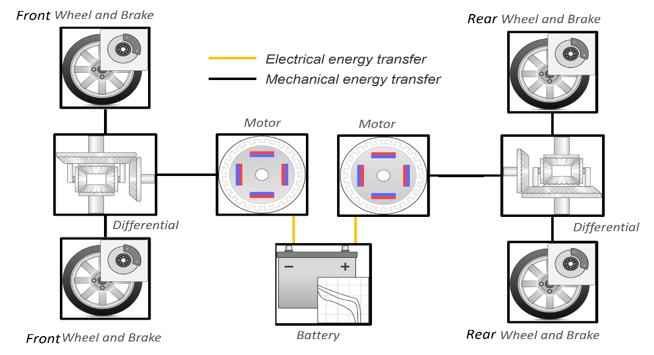
Vehicle Configuration
Powertrain Architecture: Battery-electric (EV-2M).
Drivetrain
Braking System
Battery Management System

Slide 12
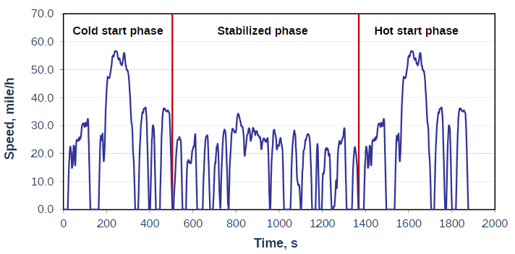
Approach
Drive Cycle:
Apart from this we also verified our controller on WLTP-3 and US-06 drive cycles.
Fig- US EPA Urban Dynamometer Driving Schedule (FTP-75)

Slide 13
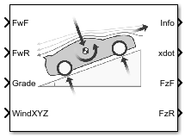
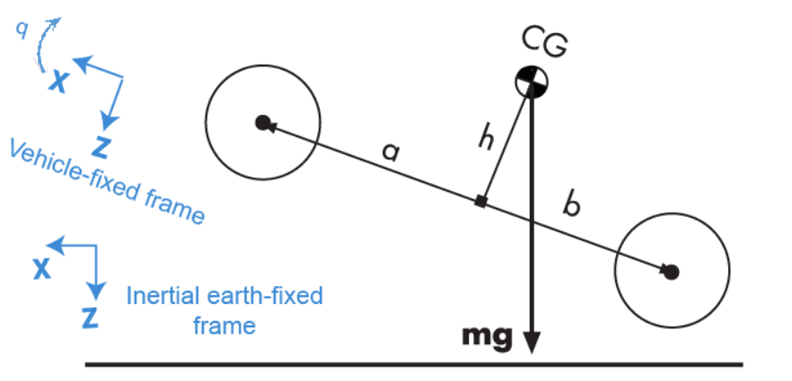
Dynamics System vs Predictive Model
Simulink's Vehicle Body 3DOF Longitudinal block: Calculates longitudinal, vertical, and pitch motion.
Accounts for body mass, tire model, road
incline, and axle weight distribution.
Predictive model: Governed solely by the
longitudinal equation of motion.
Considers body mass, aerodynamic drag,
and rolling resistance factors.

Slide 14
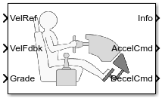
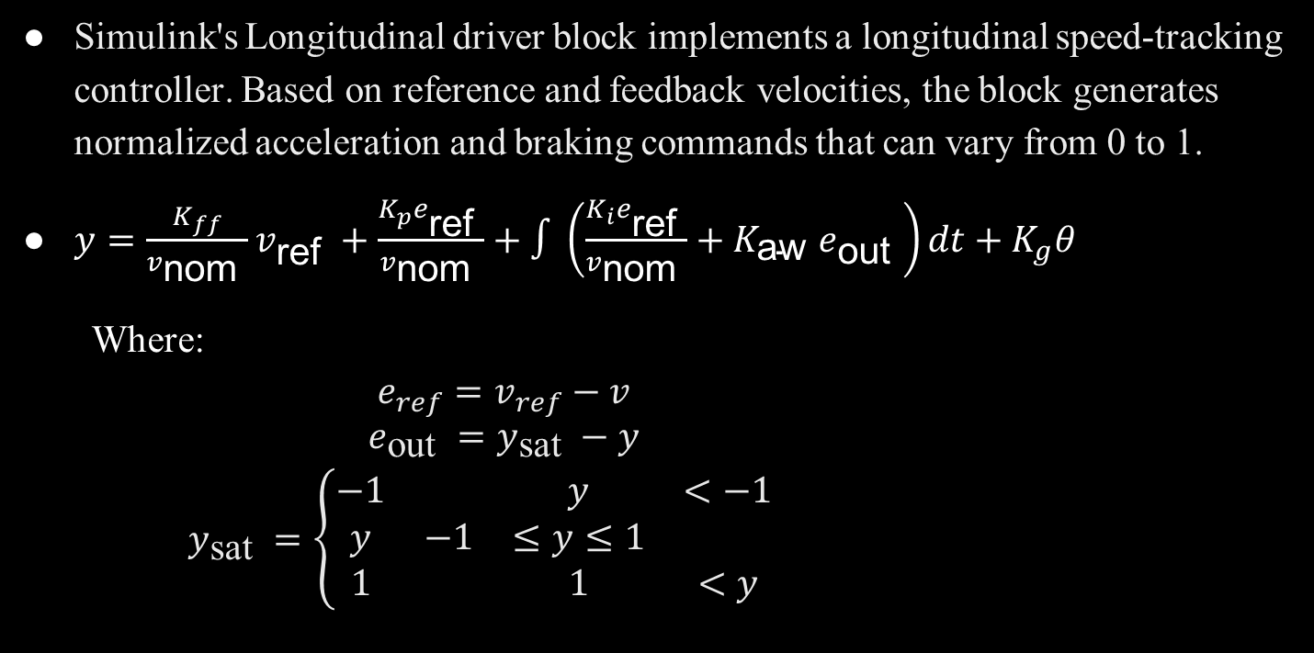
Driver Block
Simulink's Longitudinal driver block implements a longitudinal speed-tracking controller. Based on reference and feedback velocities, the block generates normalized acceleration and braking commands that can vary from 0 to 1.
$y=\frac{K_{ff}}{v_{\text{nom} }}v_{\text{ref} }+\frac{K_{p}e_{\text{ref} }}{v_{\text{nom} }}+∫\left(\frac{K_{i}e_{\text{ref} }}{v_{\text{nom} }}+K_{\text{aw} }e_{\text{out} }\right)dt+K_{g}θ$
Where:
$\begin{aligned}\begin{matrix} & e_{ref}=v_{ref}−v \\ & e_{\text{out} }=y_{\text{sat} }−y\end{matrix} \\ y_{\text{sat} }=\left\{\begin{matrix}−1 & & y & <−1 \\ y & −1 & ≤y≤1 & \\ 1 & & 1 & <y\end{matrix}\right.\end{aligned}$

Slide 15
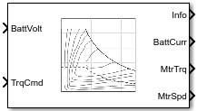
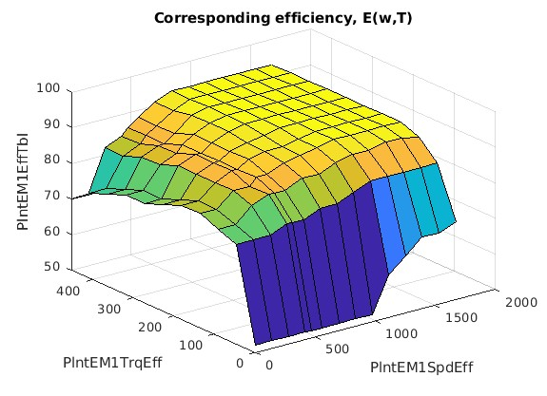
Mapped Electric Motors
Mapped Motor Block is used for fast system-level simulations when you know the detailed motor performance parameters.
Port Configuration: Input torque or speed
Electrical torque range: Torque speed envelope
or maximum motor power and torque.
Electrical loss: Single operating point,
measured efficiency, or measured loss.

Slide 16
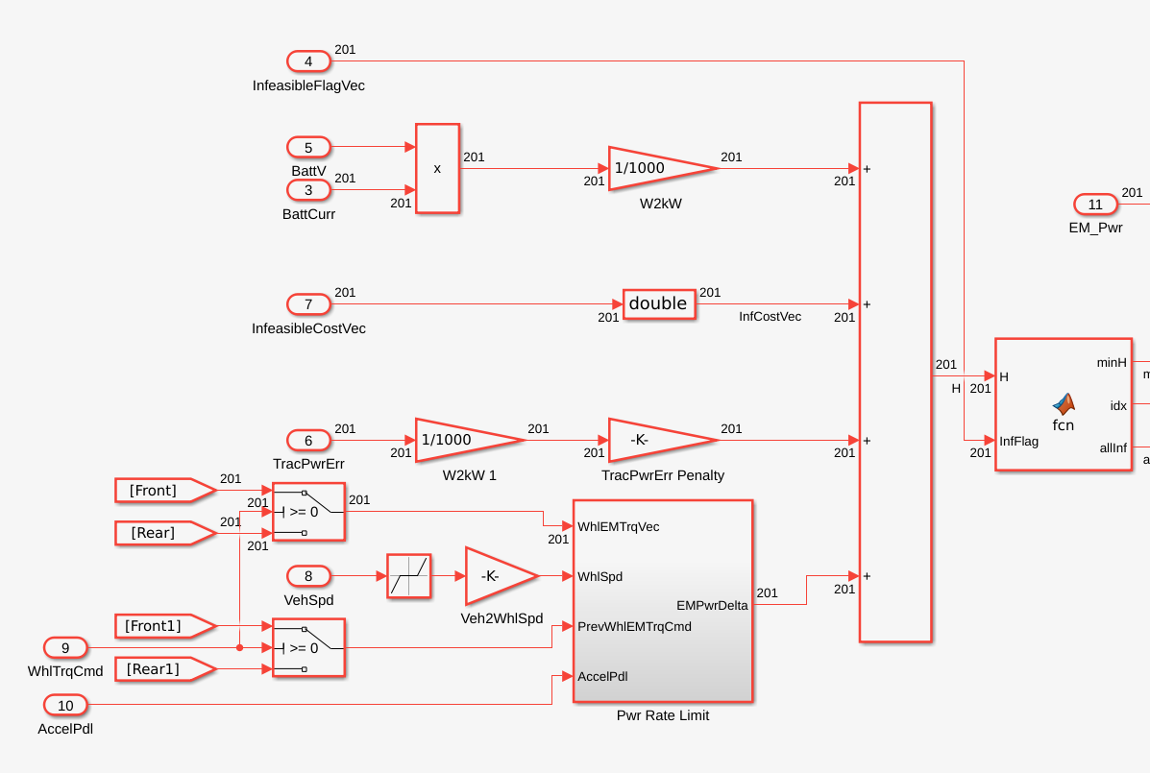
Baseline Controller
Functionality:

Slide 17
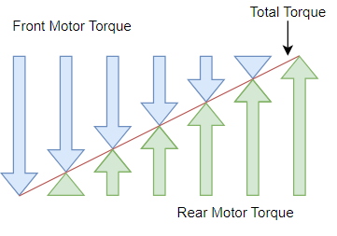
Baseline Controller
Hamiltonian optimization: Involves evaluating the Hamiltonian function at discrete control parameter intervals.
Implementation:
Creates a regularly spaced vector
of length (200 x 1) for both front and
rear motors.
Global perspective: Offers comprehensive evaluation of control options across system dynamics.

Slide 18
Baseline Controller
Functionality:
Considers power consumption for a specified control distribution as a fundamental metric.
Addresses constraints and handles infeasible control inputs to ensure operational feasibility.
Penalizes trace power and power output changes with respective weights.
Objective function for the controller is derived from the sum of all these penalties.

Slide 19
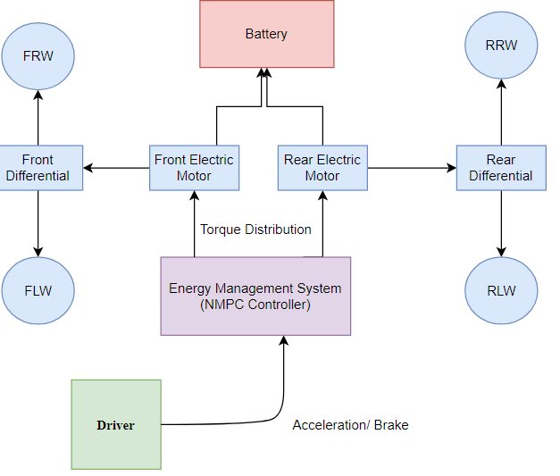
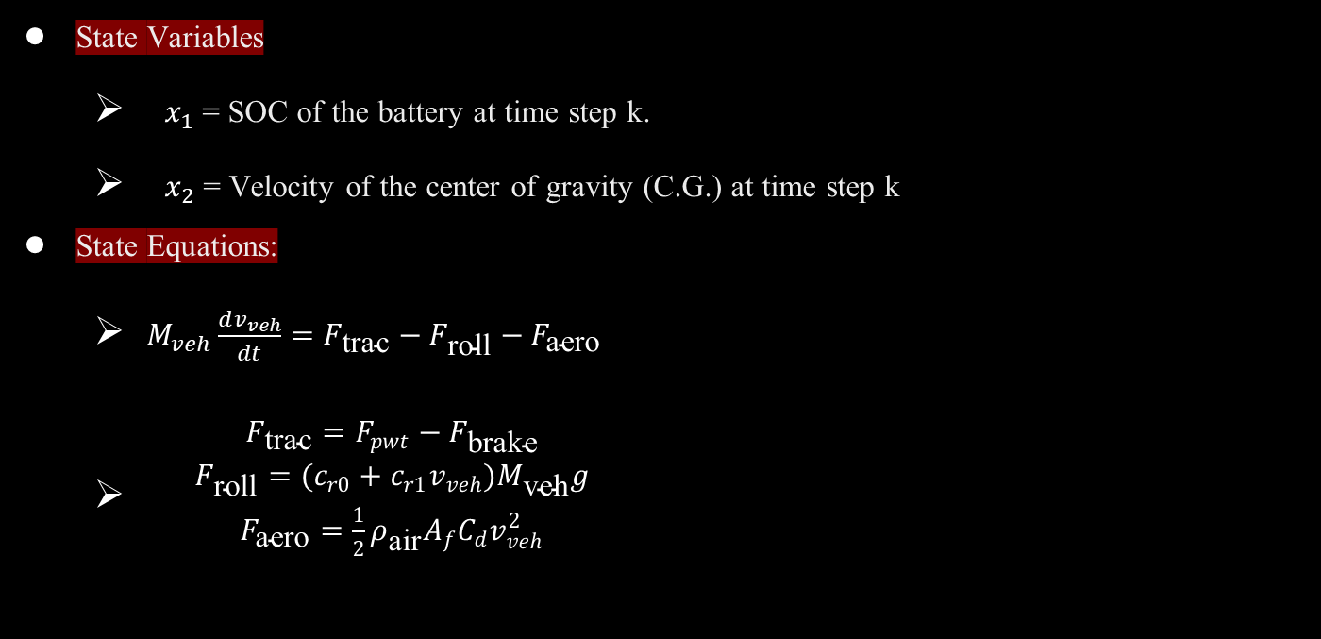
NMPC Controller
State Variables
$x_{1}$ = SOC of the battery at time step k.
$x_{2}$ = Velocity of the center of gravity (C.G.) at time step k
State Equations:
$\begin{matrix}M_{veh}\frac{dv_{veh}}{dt}=F_{\text{trac}}−F_{\text{roll}}−F_{\text{aero}}\end{matrix}$
$\begin{matrix} & F_{\text{trac}}=F_{pwt}−F_{\text{brake}} \\ & F_{\text{roll}}=(c_{r0}+c_{r1}v_{veh})M_{\text{veh}}g \\ & F_{\text{aero}}=\frac{1}{2}ρ_{\text{air}}A_{f}C_{d}v_{veh}^{2} \\ & \end{matrix}$

Slide 20

NMPC Controller
State Constraints
Restrictions on the vehicle's states, such as velocity, position, or battery state of charge, to ensure safe and stable operation. For e.g.
$$\begin{matrix} & T_{1_{−}max}(k)=F_{x1_{−}max}(k)R_{eff}=μF_{n1}(k)R_{\text{eff} }\end{matrix}$$
$$\begin{matrix} & T_{2_{−}max}(k)=F_{x2_{−}max}(k)R_{eff}=μF_{n2}(k)R_{\text{eff} }\end{matrix}$$
Control Input
Torque vectorization parameter, u ∈[0,1].
$T_{1}$= u * Torque Demand, $T_{2}$= (1-u) * Torque Demand

Slide 21

NMPC Controller
Optimization Problem
$$\min_{T_{1},T_{2}}J=\sum_{k=0}^{N−1}{(\frac{P_{\text{out}1}\left(k\right)}{η_{\text{out}1}\left(k\right)}+\frac{P_{\text{out}2}\left(k\right)}{η_{\text{out}2}\left(k\right)}}−P_{in1}(k)η_{in1}(k)−P_{in2}(k)η_{in2}(k))$$
$$s.t. ω_{m_{−}min}≤ω_{m}\left(k\right)≤ω_{m_{−}max}$$
$$T_{min}\left(ω_{m}\right)≤T_{i}\left(k\right)≤\min\left\{T_{max}\left(ω_{m}\right),T_{i_{−}max}\left(k\right)\right\}$$
$${SOC}_{min}≤SOC(k)≤{SOC}_{max}$$

Slide 22
From Experimentation to Success
Variations Explored:
Fixed timestep system with Fixed step NMPC
Variable timestep system with Variable timestep NMPC
Hybrid approach: Variable timestep system with Fixed timestep NMPC model
NMPC Parameter Tuning:
Tested N values ranging from 4 to 50 with timestep variations from 5 ms to 400 ms.
Penalty on control parameter rate of change and N and Q weight matrices.
Optimization Path: Found optimal results with Full feedback NMPC at N=10 with a timestep of 200 ms

Slide 23
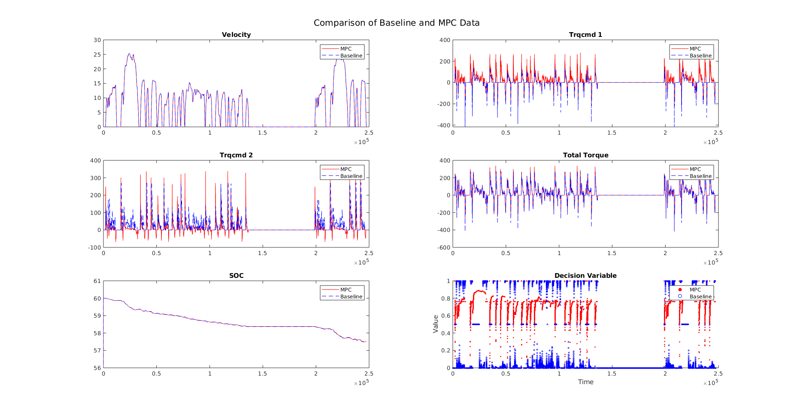
Findings

Slide 24
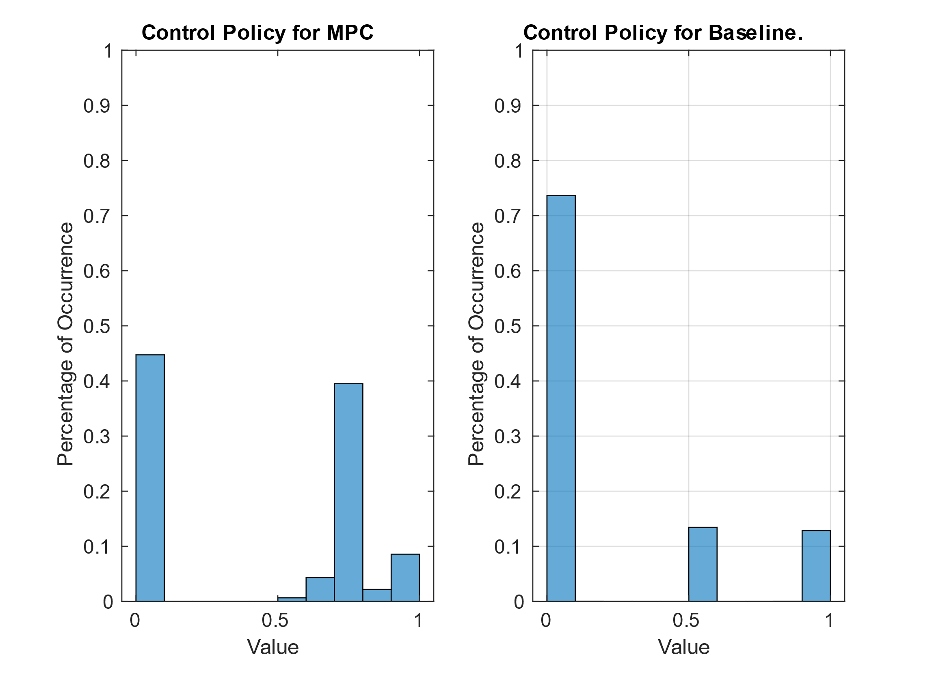
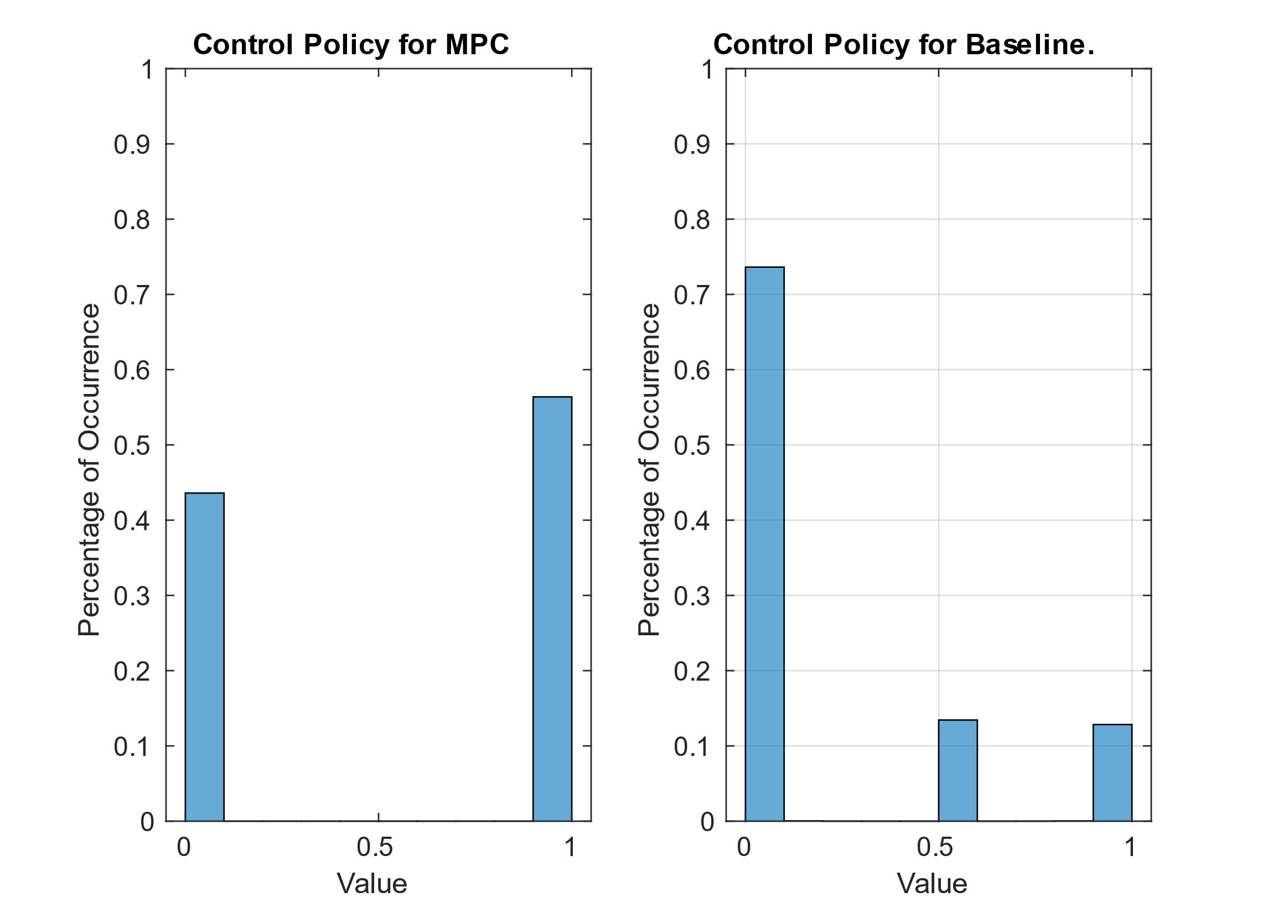
Findings
Control Policy Comparison

Slide 25
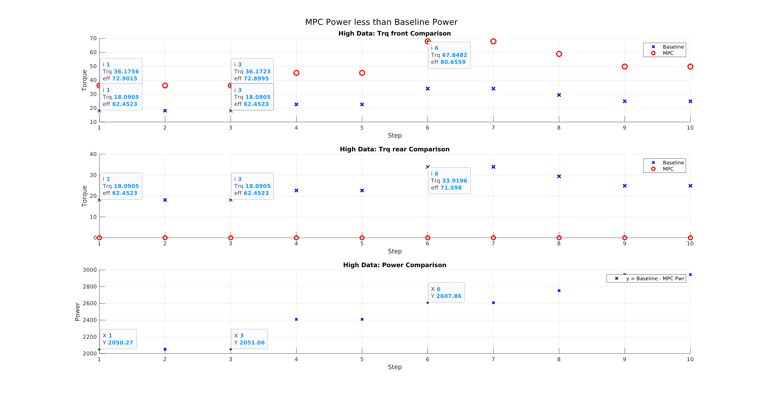
Findings
Nominal NMPC

Slide 26
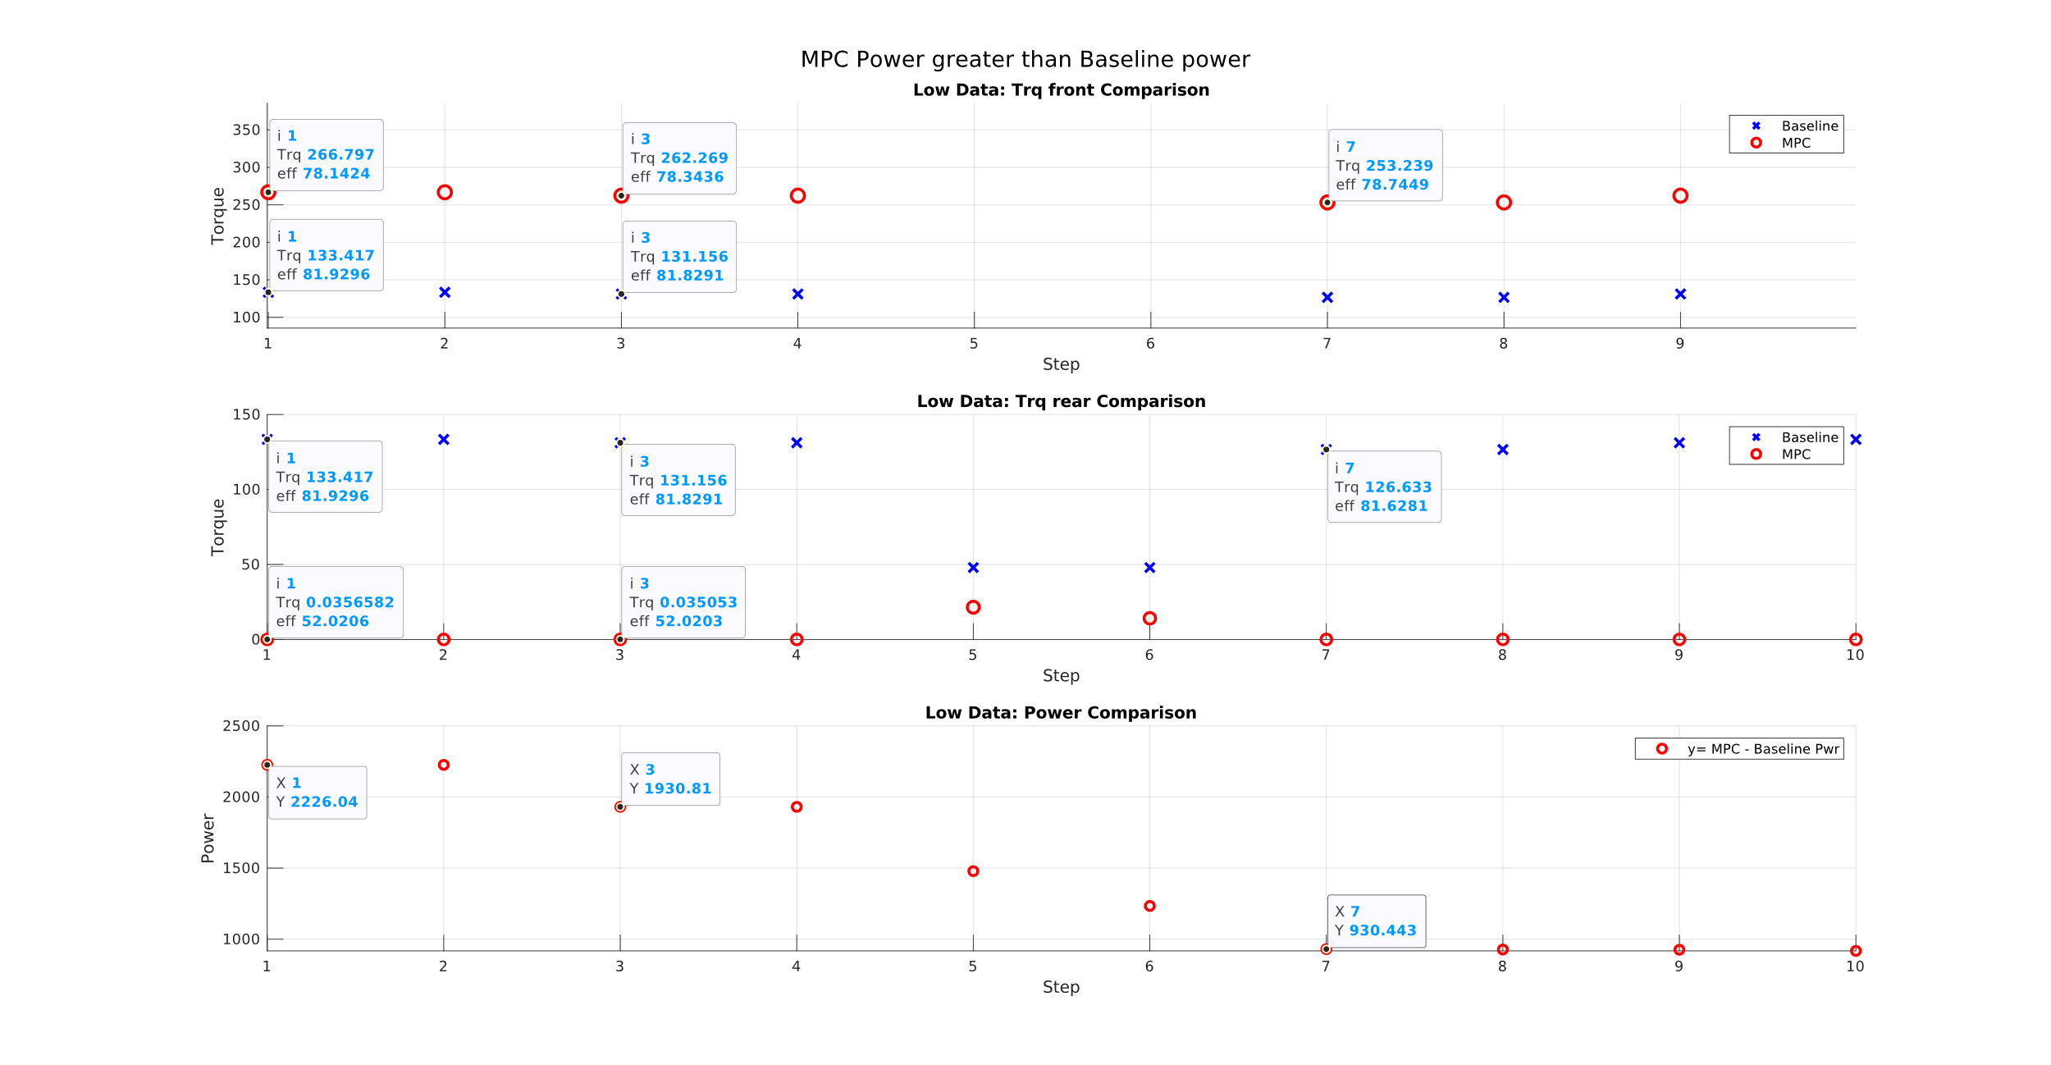
Findings

Slide 27
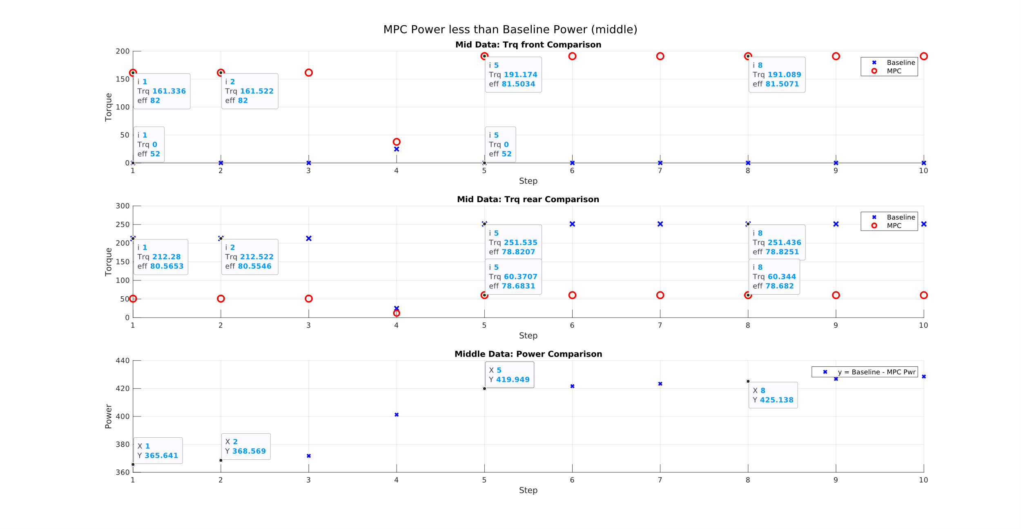
Finding

Slide 28
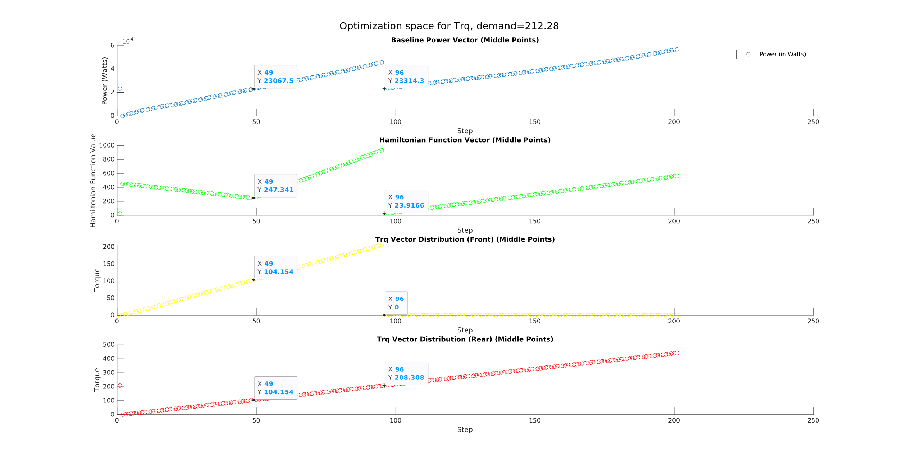
Findings

Slide 29
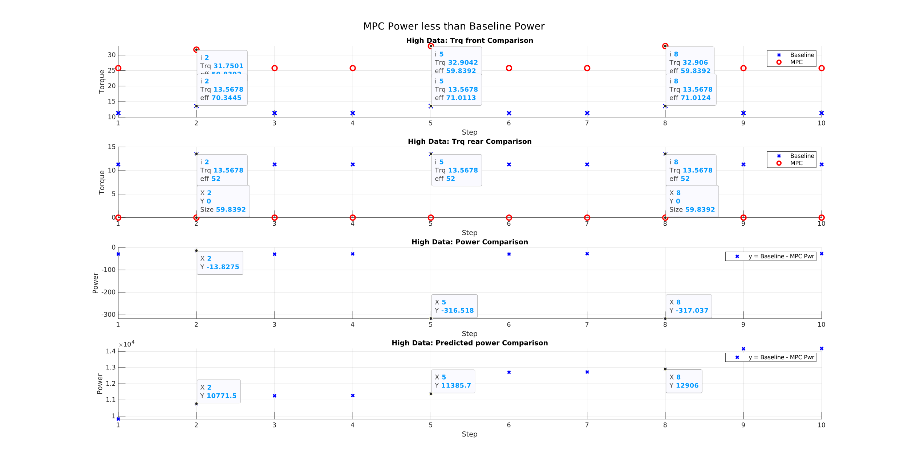
Findings

Slide 30
Progress over time

Slide 31
Global Impact of 1.07% Decrease in EV SOC Consumption
Over 26 million electric cars were on the road in 2022, up 60% from 2021.
U.S. average electricity price: 12.68 cents/kWh (Jan 2024).
Average BEV energy consumption: 25 kWh/100 miles.
Decrease: 1.07% → New consumption: 24.7325 kWh/100 miles.
Total vehicles: 26 million.
Energy savings per 100 miles: 0.2675 kWh → Total: 6,965,000 kWh.
Money saved: $ 883,162 for every 100 miles driven.

Slide 32
Conclusion
Hamiltonian optimization offers a global perspective on optimization. But large gap between two points and inability to consider future is a flaw.
NMPC tends to yield local optima solutions, heavily reliant on initial conditions of control inputs, which can significantly impact system performance.
Addressing the initialization dependency in NMPC is essential for achieving consistent and reliable control strategies.
Future research should prioritize developing innovative approaches for velocity predictions, such as RNN-based or GPS planner-based predictions, coupled with robust optimization techniques to reduce the impact of initial conditions on NMPC and improve its real-world applicability.

Slide 33
Future Work
Explore robust optimization techniques or adaptive algorithms to mitigate the influence of initialization dependency in.
Investigate advancements in optimization algorithms tailored specifically for NMPC applications to overcome initialization challenges and improve control strategy consistency.
Implement and validate proposed techniques in real-world applications to assess their practical applicability and effectiveness in improving control strategies for dynamic system.

Slide 34


Thank you

